Slide 1
Algorithmic Trading Project
“Multi Factor Market Making Algorithm to Maximise Profit by Stock Sentimental Analysis of Twitter Data”
By-
Adit Purohit
Ruturaj Bhagat
Diego Ivan Figueroa Alarcon
asp2215, rrb2151, df2761

Slide 2

GROUP NAME

Slide 3
Market Making
Market making seeks to profit by providing liquidity to other traders, while avoiding accumulating a large net position in a stock.
A market making trading strategy always or often quotes both buy and a sell price for a commodity by exploiting the spread.
A market making strategy wishes to buy and sell equal volumes of the instrument or commodity and profit from the difference between the selling and buying prices.
Notes:
Market making seeks to profit by providing liquidity to other traders, while avoiding accumulating a large net position in a stock.
A market making trading strategy always or often quotes both a buy and a sell price for a financial instrument or commodity, hoping to make a profit by exploiting the spread.
A market making strategy wishes to buy and sell equal volumes of the instrument or commodity and profit from the difference between the selling and buying prices.

Slide 4
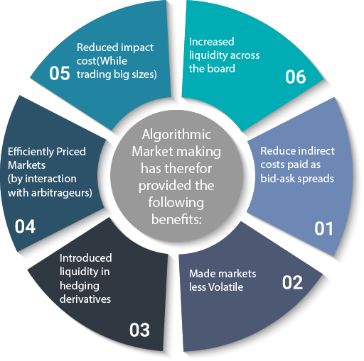
Benefits of Market Making

Slide 5
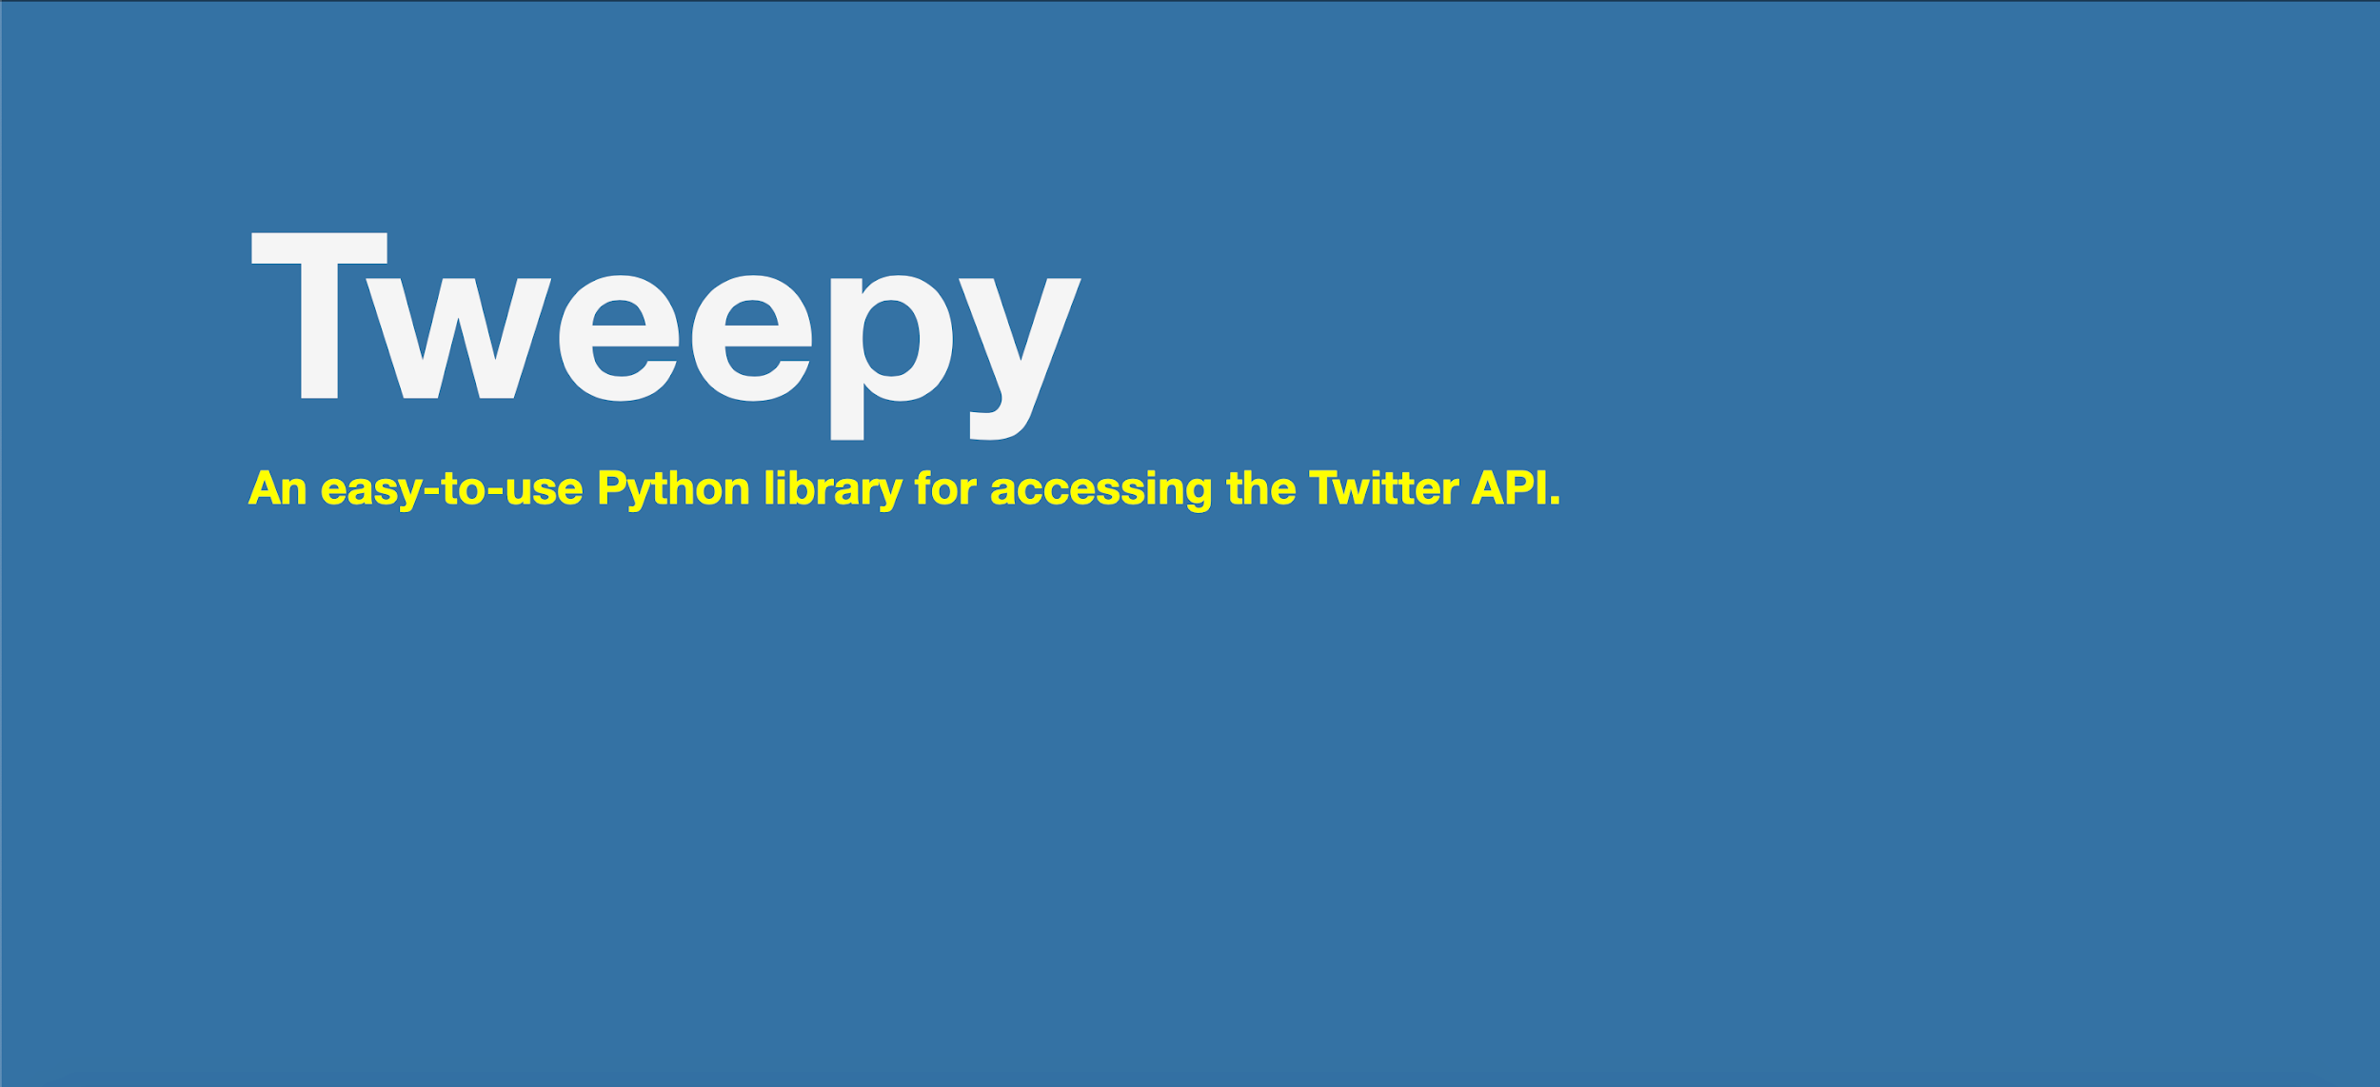

Sentimental Data
Notes:
Twitter is one of the most widely used social networks. For many organizations and people, having a great Twitter presence is a key factor to keeping their audience engaged. People share their views on twitter.
We extracted latest 100 shares each minute(can talk about limitation of tweepy) and used VADER.

Slide 6

Sentiment Analysis
VADER
(Valence Aware Dictionary and sEntiment Reasoner)
Advantages:
Punctuation
Capitalisation
Degree Modifier
Conjunctions
Preceding Tri-gram
Notes:
VADER- a lexicon and rule-based sentiment analysis tool that is specifically attuned to sentiments expressed in social media.
It gives values to each word based on many criterions and gives a compiled list of values;
It gives positive, negative, neutral and compound %
CAP- If letters are capital then more weightage (“GREAT” > “great”)
Punct - example ‘!’
Degree - adjectives (“extremely”)
Conjunctions - like “but” denotes a shift in polarity
Pre - polarity shifters
It is fast enough to be used online with streaming data
It does not severely suffer from a speed-performance tradeoff

Slide 7

Sentiment Coefficient
Vestibulum congue mpu
3
Calculation of Fair value
1
2
Sentimental Extraction using tweepy
Form: %positive, %negative, %neural
Sentimental Coefficient
The percentage of increase or decrease of sentiment
3
Determine appropriate trading behavior
Notes:
The Sentimental Implementation has two principal components in the code:
Firstly, we use it to create a sentimental coefficient that helps us determine a fair value which specifies our bid and ask price at the time of doing passive trades.
Secondly, it helps us determine the appropriate behaviour while trading by telling us if we should do an aggressive buy, aggressive sell or maintain a passive trading behaviour which depends on our bid and ask prices and the market itself, just as the original market maker strategy.
This sentimental indicator takes into account two parameters: the positive and negative sentiment. In order to use it in our code, we needed to compare the sentimental data obtained in the present minute with the one we got in the previous minute to understand if the market sentiment has improved or worsened.

Slide 8

Sentiment Analysis Approach
We began by obtaining the 100 latest tweets about our company during a given minute with Tweepy
We used the Vader dictionary package to categorise the data as positive, negative or neutral in terms of percentages
We used them to generate a composite score of whether the market reaction is Positive or Negative at any given minute
This scored was then used for the Fair value Calculation.

Slide 9
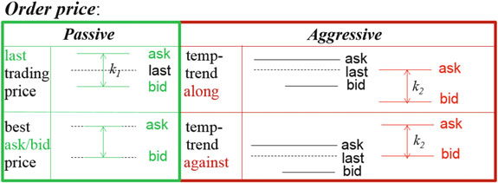
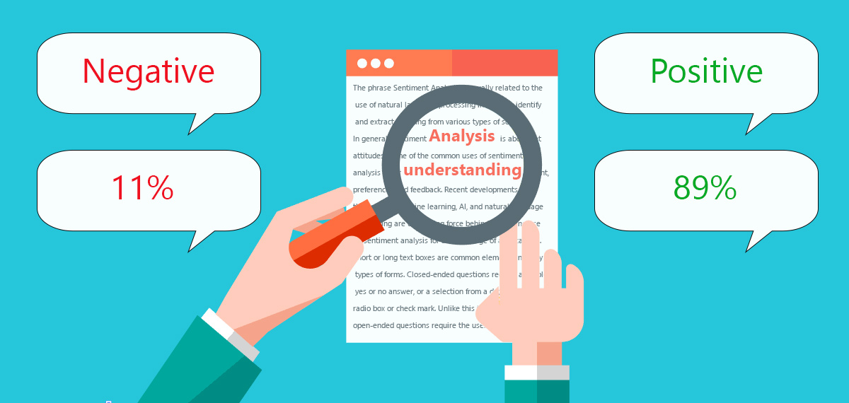
Notes:
In order to do an aggressive buy, the positive sentimental percentage increment has to be larger than the negative increment and the positive sentimental increment (difference between the current one and the previous one) has to be larger than X% of the previous positive sentimental number (where X is a float parameter between 0 and 1 that we also want to optimize).

Slide 10
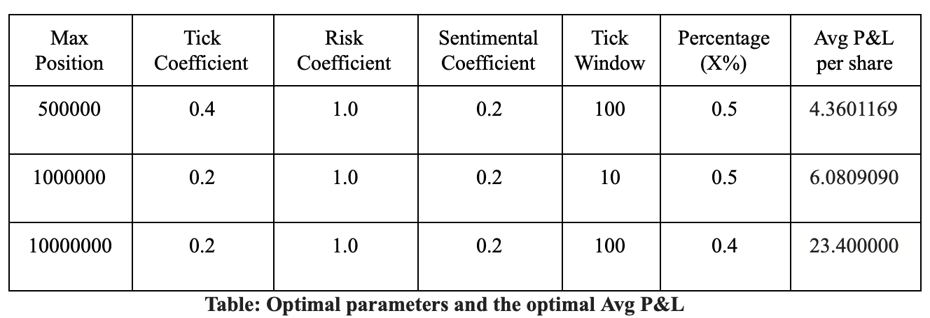
Grid Search - to find optimal values

Slide 11
In order to show the impact of our implementation, we increased the tick coefficient until we got both a considerable amount of trades per side and some aggressive buys and sells along the time range using every position, so the increment in the tick coefficient wasn’t the same in all the cases.
Parameters | Shares Traded | Avg P&L per share
Max position = 500000 Tick Coefficient = 0.7 | buy count : 50 sell count : 51 | 2.666723668868599
Max position = 1000000 Tick Coefficient = 0.5 | buy count : 83 sell count : 84 | 1.611432252020677
Max position = 10000000 Tick Coefficient = 0.5 | buy count : 141 sell count : 142 | 1.95050463796224

Slide 12
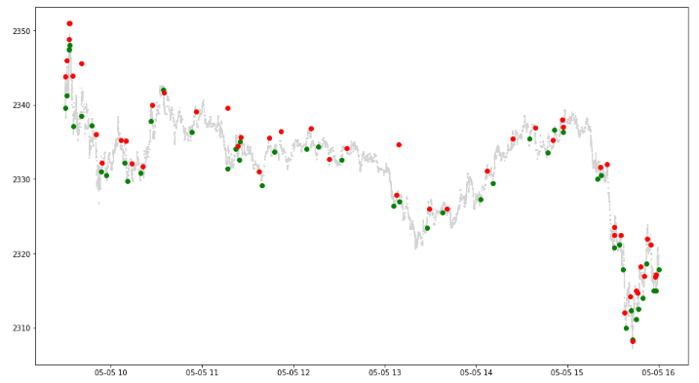
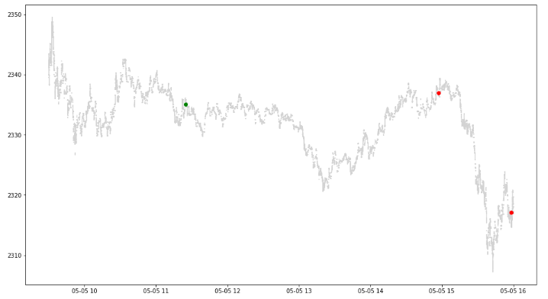
500K Max Position

Slide 13
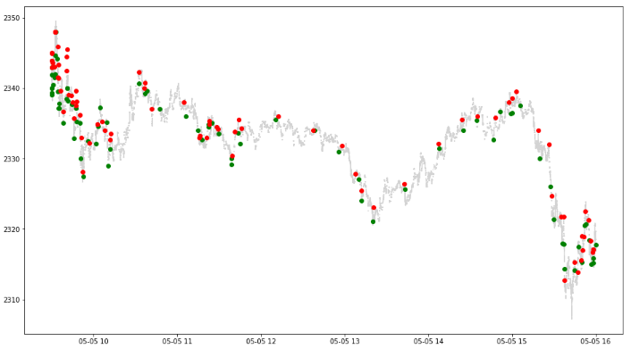
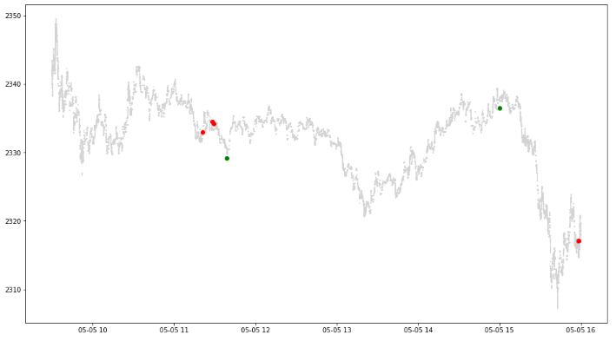
1M Max Position

Slide 14
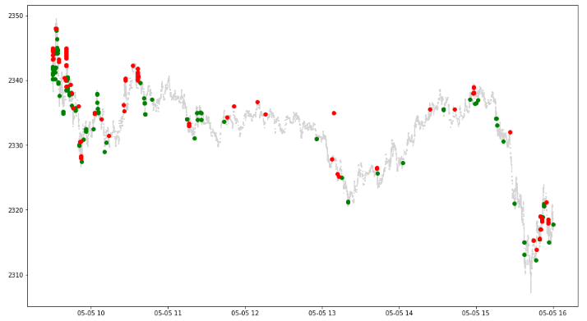
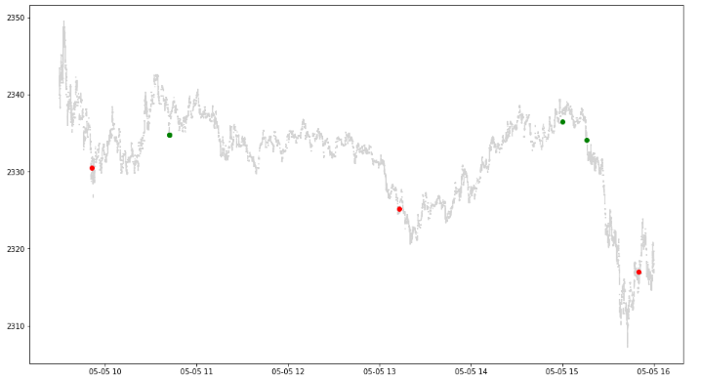
10M Max Position

Slide 15

The End

